Slide 1

Employee Management System

Slide 2


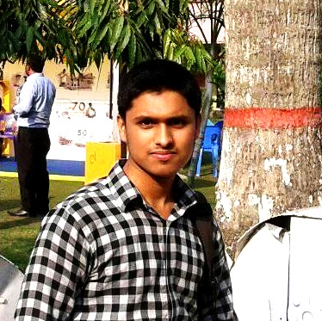

TEAM UNITY
Md. Arafat Rahman
CSE06307434
Saikat Hussain
CSE06307459
Rishad Istiak Sachcha
CSE06307451

Slide 3
EXISTING SYSTEM
Manual
Time consuming
Dependent on employee
Insecurity

Slide 4
NEED FOR NEW SYSTEM
Computerized
Time saving
Independent of employee
Security

Slide 5
HARDWARE & SOFTWARE REQUIREMENT
HARDWARE
Processor - 1.7 or above
Ram - 2GB or above
SOFTWARE
Operating System - windows 7 or compatible
Server - xaamp is used as local

Slide 6

FEATURES

Slide 7

Employee details

Slide 8

Time and attendance tracking

Slide 9

Updates and notifications

Slide 10
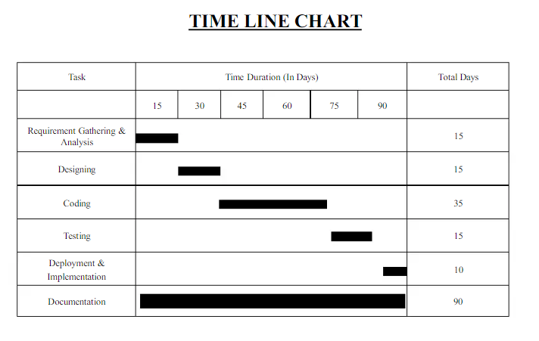

Slide 11


OUR SPECIALIZED OFFERINGS
Premium User Interface
Well filtered
Tested & Secured by security expert

Slide 12
POSSIBLE PROFIT RATE

Slide 13




THANK YOU!
TEAM_UNITY
team_unity@example.com
678-555-0100

